Slide 1
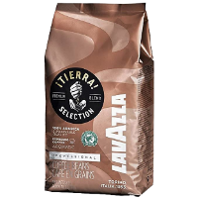
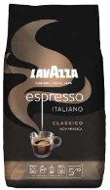
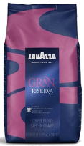
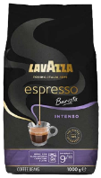
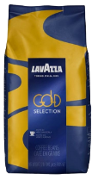
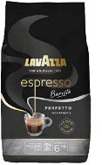
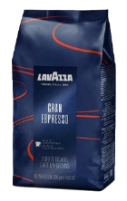
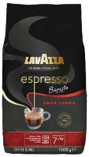
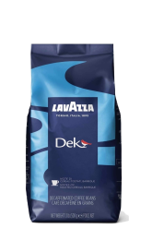
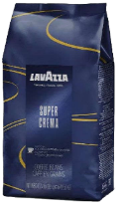
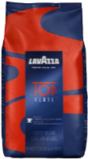
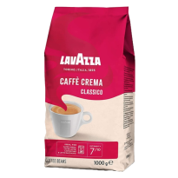
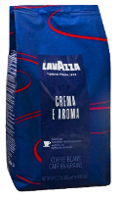
CENTRAL AMERICA: MILD AND BALANCED, CITRUS, FLORAL, CARAMEL SWEETNESS
ESPRESSO ITALIANO
CLASSICO
100% Arabica
TIERRA
100% Arabica
HONDURAS: Light Body Crisp, Nutty & Spicy
GRAN RISERVA
80% Arabica
20% Robusta
COSTA RICA: Medium Body, Citrus, Nutty
Barista INTENSO
Arabica
Robusta
SOUTH AMERICA: MILD AND BALANCED, CITRUS, FLORAL, CARAMEL SWEETNESS
GOLD
70% Arabica
30% Robusta
Barista
PERFETTO
100% Arabica
BRAZIL: Medium Body, Caramel & Chocolate, Flowery and fruity
PERU: Medium Body and acidity
GRAN ESPRESSO
60% Arabica
40% Robusta
COLOMBIA: Medium Body & Acidity, Fruity and Nutty
Barista GRAN
CREMA
Arabica
Robusta
AFRICA: BRIGHT, ACIDIC, FRUITY, MEDIUM BODY
SUPER CREMA
60% Arabica
40% Robusta
Dek (Decaf)
60% Arabica
40% Robusta
UGANDA: Full Body, Chocolate, Creamy, Vanilla
TOP CLASS
50% Arabica
50% Robusta
CAFFE CREMA CLASSICO
70% Arabica
30% Robusta
ASIA: EARTHY, CHOCOLATY, SWEET, HEAVY BODY
INDIA: Full Body, Medium Acidity
CREMA
E AROMA
40% Arabica
60% Robusta
JAVA: Full Body, Low Acidity
INDONESIA: Full Body, Low Acidity, Sweet, Cocoa notes
VIETNAM: Full Body, Nutty Flavors, Darker roast, Low acidity

